Slide 1
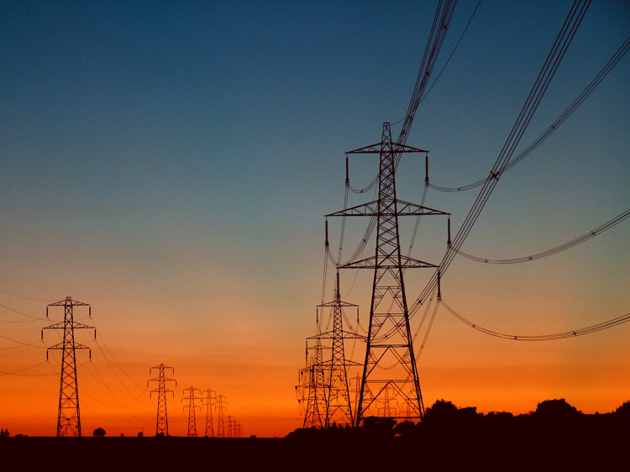
Electric Current and Resistance
Physics
Mrs. Coyle

Slide 2
Part I
Basic electric circuit and its diagram.
What causes the flow of electrons in a circuit.
Drift velocity.
Voltaic cell.

Slide 3
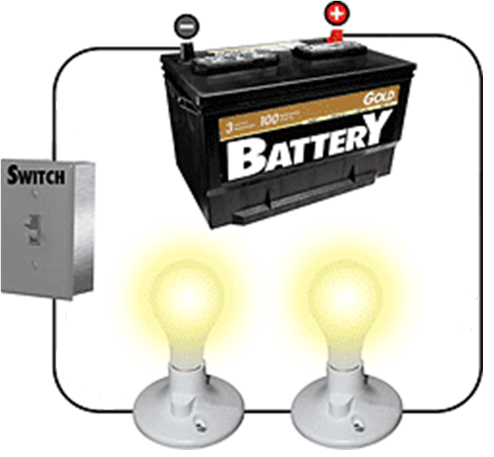
Electric Circuit

Slide 4

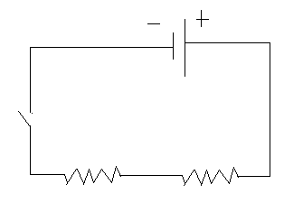
Diagram of Electric Circuit

Slide 5
Remember: Electric Potential Energy-
Two Unlike Charges
+
Higher Potential Energy
-
Lower Potential Energy
To cause movement of a charge, there must be a potential difference.

Slide 6
While the switch is open:
Free electrons (conducting electrons) are always moving in random motion.
The random speeds are at an order of
10⁶ m/s.
There is no net movement of charge across a cross section of a wire.

Slide 7
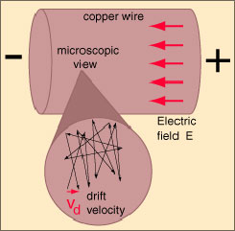
What occurs in a wire when the circuit switch is closed?
http://hyperphysics.phy-astr.gsu.edu/HBASE/electric/imgele/micohm.gif

Slide 8
What occurs in a wire when the circuit switch is closed?
An electric field is established instantaneously (at almost the speed of light, 3x10⁸ m/s).
Free electrons, while still randomly moving, immediately begin drifting due to the electric field, resulting in a net flow of charge.
Average drift velocity is about 0.01cm/s.

Slide 9
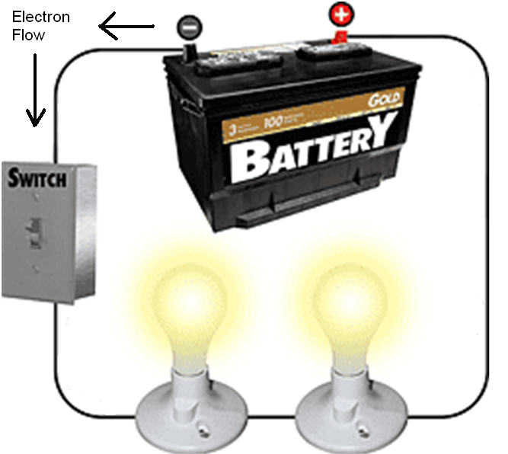
Closing the switch establishes a potential difference (voltage) and an electric field in the circuit.
High Potential
Low Potential
Electrons flow in a net direction away from the (-) terminal.

Slide 10
Question:
If the drift velocity is about 0.01cm/s, why do the lights turn on instantaneously when the circuit switch is closed?

Slide 11
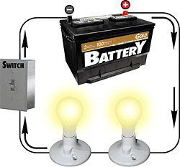
Conventional Current
By tradition, direction in which “positive charges” would flow.
Direction is opposite of electron flow.

Slide 12
Question:
What is required in order to have an electric current flow in a circuit?
Answer:
  A voltage source.
  The circuit must be closed.

Slide 13
Battery (Chemical Cell):
A device that converts chemical energy to electricity.
A battery provides a potential energy difference (voltage source).

Slide 14
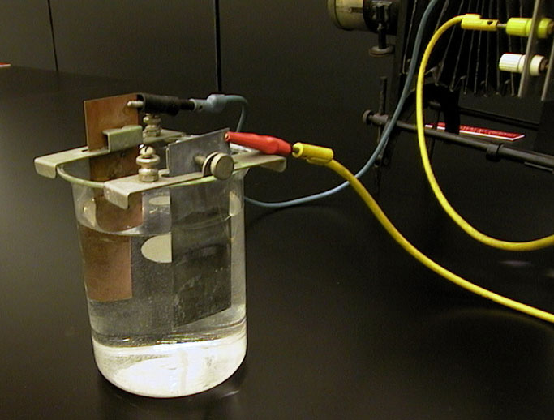
Voltaic Cell
Alessandro Volta (1800’s)
Battery

Slide 15
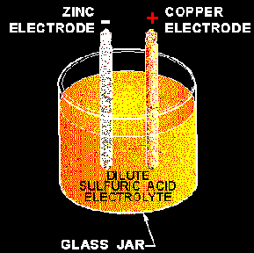

Slide 16
Cu and Zinc Electrodes. Why?

Slide 17

Question: Why is the bird on the wire safe?

Slide 18
Question:
Why do electricians work with one hand behind their back?

Slide 19
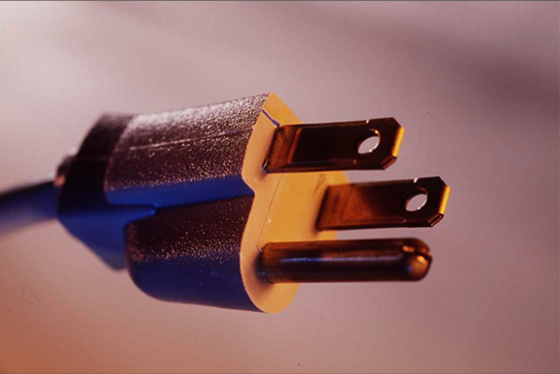
Question:
Why is the ground prong longer than the other two in a plug?

Slide 20
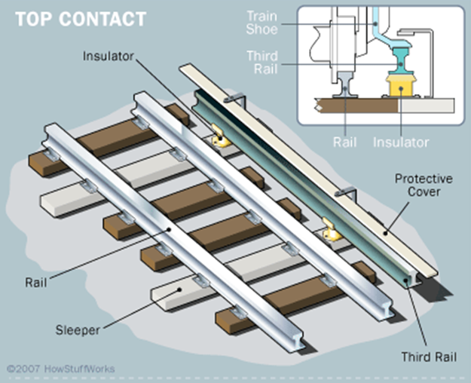
Example: Third rail of subway
http://static.howstuffworks.com/gif/subway-track.gif

Slide 21
Part II
Electric Current
Ammeter
Resistance
Resistor

Slide 22
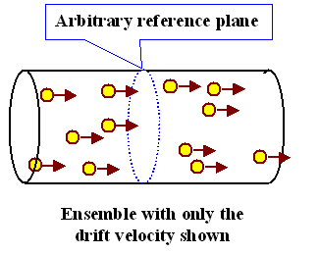
Electric Current:
The flow of electric charges.

Slide 23
Electric Current, I
I = q
t
Rate
Unit: Coulomb / sec = Ampere (A)
Andre Ampere (1775-1836)

Slide 24
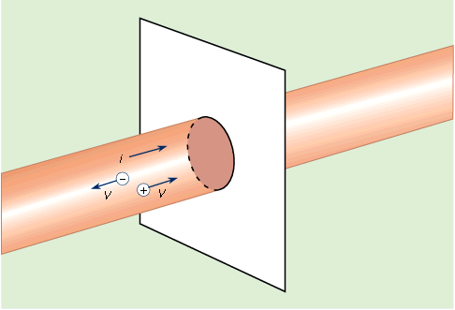
Conventional current has the direction that the (+) charges would have in the circuit.
http://media-2.web.britannica.com/eb-media/36/236-004-D4AA985F.gif

Slide 25
Direct Current
DC
Provided by batteries
Alternating Current
AC
Provided by power companies

Slide 26
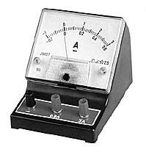
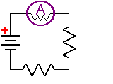
Ammeter
Measures electric current.
Must be placed in series.

Slide 27
Example:
What charge flows through a cross sectional area of a wire in 10min, if the ammeter measures a current of 5mA?
Answer: 3C

Slide 28
Resistance
Resistance of an object to the flow of electrical current.
R= V / I
Resistance equals the ratio of voltage to current.
Unit: Ohm (Ω)

Slide 29
Ohm’s Law (Georg Ohm,
1787-1854)
  V = IR
The voltage , V, across a resistor is proportional to the current, I, that flows through it.
In general, resistance does not depend on the voltage.

Slide 30
Ohmic Resistor
A device that obeys Ohm’s Law, who’s resistance does not depend on the voltage.

Slide 31
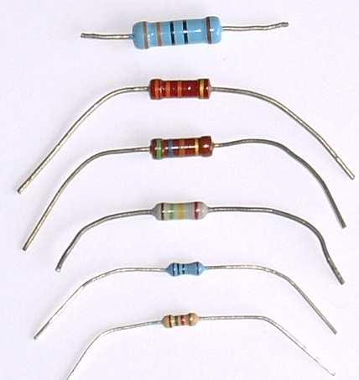
Resistor
An object that has a given resistance.

Slide 32
A Battery Provides Energy
The battery “pumps” positive charges from
low (-) to
high (+) potential.
Electric Circuit

Slide 33
Resistors use up Energy
A resistor uses up energy.
When the current goes through the resistor it goes to a lower potential.
Electric Circuit

Slide 34
Question:
Which point has a lower potential, A or B?
Electric Circuit

Slide 35
Example:
Calculate the current through a 3 Ω resistor when a voltage of 12V is applied across it.
Answer: 4 A

Slide 36
Example:
A 6 Ω resistor has a power source of 20V across it. What will happen to the resistance if the voltage doubles?

Slide 37
Part III
Factors that affect resistance.
Potentiometer
Voltmeter

Slide 38
Resistance
Depends on type of material, size and shape, temperature.
R=ρ L
A
L: length of the wire
A: cross-sectional area
ρ: resistivity (inherent to material)

Slide 39
Example:
What happens to the resistance when the length is doubled and the area is quadrupled?
Answer: It changes by 1/2

Slide 40
Temperature Dependence of Resistance
For metals: as temperature increases the resistance increases. At very low temperatures resistance can become zero: superconductivity.
For semiconductors: the opposite occurs.

Slide 41
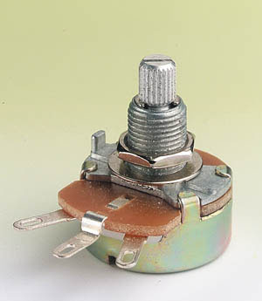
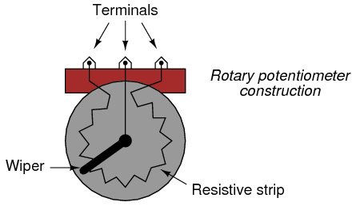
Potentiometer
A variable resistance.
Used for dimmers, fan speed controls, etc.

Slide 42

Potentiometer Symbol

Slide 43
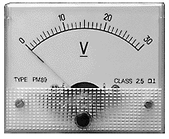
Voltmeter
Measures the voltage between two points in an electric circuit.
Must be connected in parallel.

Slide 44
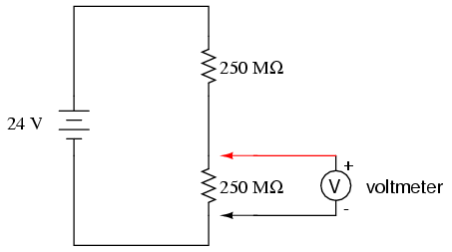
A voltmeter is connected in parallel.

Slide 45
Ammeter
Measures electric current.
Must be placed in series.

